Slide 1
Diversity and Culture in Health Care

Slide 2
What is diversity?

Slide 3
What is culture?

Slide 4
What is ethnicity?

Slide 5
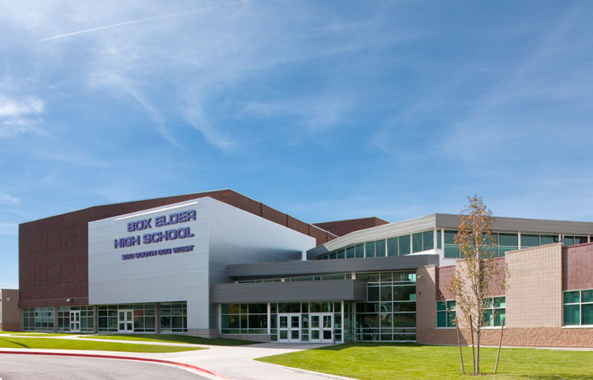
Diversity in the classroom
How are we diverse as a high school?
Some ideas
Age
Ethnicity/National Origin
Gender
Religion
Education
Mobility/disability

Slide 6
Ok, so how does all this apply to health care?
The goal of health care is……
To provide optimal care to each patient, as an individual
What does that mean and how do we do that?
Physical and emotional/psychological care
Best practice, understand differences, mutual respect
Appreciate diversity!!

Slide 7
American culture
What makes us American?
Notes:
How are we different from other nationalities

Slide 8
What are some ways that our culture might be different than your patient?
Some ideas
Language
Name use
Eye contact
Pain tolerance
Diet
Visitors and family
Modesty
Ideas about child birth
Acceptance of folk medicine and ritual

Slide 9
Other elements of diversity
How do you meet the needs of someone with a different …
Age
Gender
Ethnicity/Nationality
Religion

Slide 10
Physical characteristics of a health care professional
What do you expect from the professionals you see?
Proper hygiene
Proper dress

Slide 11
Behavioral characteristics of a health care professional
What do you expect from a professional you see?
Honesty
Empathy
Dependability
Team work
Life-long learner

